Slide 1
PEFA 2016
and example of its recent application in Albania
Slides partially selected from the training materials of the PEFA secretariat

Slide 2
PEFA objectives

Slide 3
PEFA Guiding principles
A country-led agenda: a country led PFM reform strategy and action plan.
A coordinated program of support: an integrated, multi-year program of support from international development partners that is aligned with the government’s strategy.
A shared information pool: a framework for measuring results that provides consistent information on country PFM performance, including progress over time.
Notes:
PEFA approach to PFM:
A country-led PFM reform program, including a strategy and action plan reflecting country priorities; implemented through government structures
A coordinated program of support, covering analytical, technical and financial support
A common information pool, based on a framework for measuring performance and monitoring results over time i.e. the PFM Performance Measurement Framework

Slide 4
PEFA Framework in a nutshell
PEFA is a standardized methodology with two components
A standard set of high level PFM indicators to assess performance
A concise, integrated performance report
Its purpose is to:
Provide a thorough, consistent and evidence-based analysis of PFM performance at a specific point in time
Assess how PFM impacts on key budget outcomes - fiscal discipline, efficient resource allocation, efficient service delivery
Establish the foundation for analyzing and improving in PFM
PEFA does not:
Assess causes for good or poor performance
Assess government policies

Slide 5
What does the PEFA framework cover? PEFA and GFS 2014 structure of the public sector
Public sector
General government
Central government
State governments
Public corporations
Local governments
Social security funds
Budgetary
Extrabudgetary
Social security funds
Notes:
The core PEFA methodology was initially focused on central government, including related oversight and accountability institutions, such as the legislature and supreme audit institutions.
The scope of the category of “central government”, as used in PEFA, is based on the classification structure developed by the International Monetary Fund (IMF) for Government Finance Statistics (GFS).
PEFA methodology refers to the GFS terminology where possible to provide a standard basis of reference, but this does not imply that PEFA is only relevant where GFS methodology is used. PEFA is adaptable to situations where other classifications and standards are used.
The PEFA indicator set is focused on the financial operations of the entire level of government covered by the assessment.
For instance, activities of central government implemented outside the budget are included in the coverage of a small number of indicators and are referred to as expenditure and revenue of extrabudgetary units and expenditure and revenue related to the extrabudgetary activities of budgetary units—for example, in PEFA indicator (PI)-6.
Public corporations are referred to in PI-10. Subnational governments with a direct relationship to central government are referred to in PI-7 and PI‑10.
While initially developed for central government PEFA has increasingly been used in the assessment of subnational government PFM performance.

Slide 6
7 PEFA pillars of PFM performance
Pillar One
Budget reliability
Pillar Two
Transparency of public finances
Pillar Three
Management of assets and liabilities
Pillar Four
Policy-based fiscal
strategy and budgeting
Pillar Five
Predictability and control in budget execution
Pillar Six
Accounting and reporting
Pillar Seven
External scrutiny and audit
Notes:
PEFA identifies seven pillars of performance in an open and orderly PFM system that are essential to achieving these objectives. The seven pillars thereby define the key elements of a PFM system. They also reflect what is desirable and feasible to measure. The pillars are as follows:
Budget reliability. The government budget is realistic and is implemented as intended. This is measured by comparing actual revenues and expenditures (the immediate results of the PFM system) with the original approved budget.
Transparency of public finances. Information on PFM is comprehensive, consistent, and accessible to users. This is achieved through comprehensive budget classification, transparency of all government revenue and expenditure including intergovernmental transfers, published information on service delivery performance and ready access to fiscal and budget documentation.
Management of assets and liabilities. Effective management of assets and liabilities ensures that public investments provide value for money, assets are recorded and managed, fiscal risks are identified, and debts and guarantees are prudently planned, approved, and monitored.
Policy-based fiscal strategy and budgeting. The fiscal strategy and the budget are prepared with due regard to government fiscal policies, strategic plans, and adequate macroeconomic and fiscal projections.
Predictability and control in budget execution. The budget is implemented within a system of effective standards, processes, and internal controls, ensuring that resources are obtained and used as intended.
Accounting and reporting. Accurate and reliable records are maintained, and information is produced and disseminated at appropriate times to meet decision-making, management, and reporting needs.
External scrutiny and audit. Public finances are independently reviewed and there is external follow-up on the implementation of recommendations for improvement by the executive.
Within the seven broad areas marked by these pillars, PEFA defines 31 specific indicators that focus on key measureable aspects of the PFM system. PEFA uses the results of the individual indicator calculations, which are based on available evidence, to provide an integrated assessment of the PFM system against the seven pillars of PFM performance. It then assesses the likely impact of PFM performance levels on the three desired budgetary outcomes: aggregate fiscal discipline, strategic allocation of resources, and efficient service delivery.

Slide 7
PEFA and the budget cycle
Policy-based fiscal
strategy and budgeting
Transparency of public finances
External scrutiny and audit
Management of assets and liabilities
Predictability and control in budget execution
Budget reliability
Accounting and reporting

Slide 8
PEFA performance indicators
I. Budget Reliability
PI-1. Aggregate expenditure outturn
PI-2. Expenditure composition outturn
PI-3. Revenue outturn
II. Transparency of public finances
PI-4. Budget classification
PI-5. Budget documentation
PI-6. Central government operations outside financial reports
PI-7. Transfers to subnational governments
PI-8. Performance information for service delivery
PI-9. Public access to fiscal information
III. Management of Assets & liabilities
PI-10. Fiscal risk reporting
PI-11. Public investment management
PI-12. Public asset management
PI-13. Debt management
IV. Policy-based fiscal strategy and budgeting
PI-14. Macroeconomic and fiscal forecasting
PI-15. Fiscal strategy
PI-16. Medium-term perspective in expenditure budgeting
PI-17. Budget preparation process
PI-18. Legislative scrutiny of budgets
V. Predictability and control in budget execution
PI-19. Revenue administration
PI-20. Accounting for revenue
PI-21. Predictability of in-year resource allocation
PI-22. Expenditure arrears
PI-23. Payroll controls
PI-24. Procurement
PI-25. Internal controls on nonsalary expenditure
PI-26. Internal audit
VI. Accounting and reporting
PI-27. Financial data integrity
PI-28. In-year budget reports
PI-29. Annual financial reports
VII. External scrutiny and audit
PI-30. External audit
PI-31. Legislative scrutiny of audit reports

Slide 9
Pillar five: Predictability and control in budget execution
PI-19 Revenue administration
PI-20 Accounting for revenue
PI-22 Expenditure arrears
PI-23 Payroll controls
PI-24 Procurement
PI-21 Predictability of in-year resource allocation
PI-25 Internal controls on nonsalary expenditure
The budget is implemented within a system of effective standards, processes, and internal controls, ensuring that resources are obtained and used as intended.
PI-26 Internal audit

Slide 10
Pillar five: Predictability and control in budget execution
21.1 Consolidation of cash balances
21.2 Cash forecasting and monitoring
PI-21 Predictability of in-year resource allocation
21.3 Information on commitment ceilings
21.4 Significance of in-year budget adjustments
Description and main improvements
Extent to which the central ministry of finance is able to forecast cash commitments and requirements and to provide reliable information on the availability of funds to budgetary units for service delivery Consolidation of cash balances – shifted here (PEFA 2011 PI-17 (ii)) Scoring method – changed to M2

Slide 11
Pillar five: Predictability and control in budget execution
Dimension 21.1. Consolidation of cash balances
Score Minimum requirements for scores A All bank and cash balances are consolidated on a daily basis. B All bank and cash balances are consolidated on a weekly basis. C Most cash balances are consolidated on a monthly basis. D Performance is less than required for a C score. Consolidation of cash balances exists when the government has information on the total of its cash and bank balances and can switch unused balances to meet overdrawn balances and minimize its borrowing costs. This requires that all balances are held centrally, e.g. by the central bank, or that balances held in other banks are subject to electronic clearing and payment arrangements.

Slide 12
Pillar five: Predictability and control in budget execution
Dimension 21.2 Cash forecasting and monitoring
Score Minimum requirements for scores A A cash flow forecast is prepared for the fiscal year and is updated monthly on the basis of actual cash inflows and outflows. B A cash flow forecast is prepared for the fiscal year and is updated at least quarterly on the basis of actual cash inflows and outflows. C A cash flow forecast is prepared for the fiscal year. D Performance is less than required for a C score. The cash flow forecast referred to in this dimension relates to a consolidated forecast prepared by the relevant central entity, such as a Treasury department. The forecast would normally be expected to be based on information supplied by budgetary units at least once for the year, in addition to analysis performed by the central Treasury.

Slide 13
Pillar five: Predictability and control in budget execution
Dimension 21.3 Information on commitment ceilings
Score Minimum requirements for scores A Budgetary units are able to plan and commit expenditures for at least six months in advance in accordance with the budgeted appropriations and cash/ commitment releases B Budgetary units are provided reliable information on commitment ceilings at least quarterly in advance C Budgetary units are provided reliable information on commitment ceilings at least a month in advance. D Performance is less than required for a C score. This dimension assesses the reliability of in-year information available to budgetary units on ceilings for expenditure commitment for certain periods. For commitments to be considered reliable the amount of funds for commitment or spending made available to an entity for a specific period should not be reduced during that period.

Slide 14
Pillar five: Predictability and control in budget execution
Dimension 21.4 Significance of in-year budget adjustments
Score Minimum requirements for scores A Significant in-year adjustments to budget allocations take place no more than twice in a year and are done in a transparent and predictable way B Significant in-year adjustments to budget allocations take place no more than twice in a year and are done in a fairly transparent way C Significant in-year adjustments to budget allocations are frequent and partially transparent. D Performance is less than required for a C score. This dimension assesses frequency and transparency of adjustments to budget allocations. The adjustments to be considered for this dimension are only those instigated by the MoF and not the virements within approved limits between budget lines for a single budget entity (instigated by the entity and typically of insignificant value)

Slide 15
Pillar five: Predictability and control in budget execution
PI-22 Expenditure arrears
22.1 Stock of expenditure arrears
22.2 Expenditure arrears monitoring
Description and main improvements
Extent to which: there is a stock of arrears; a systemic problem in this regard is being addressed and brought under control Moved from PEFA 2011 PI-4 and simplified

Slide 16
Pillar five: Predictability and control in budget execution
PI-23 Payroll controls
23.1 Integration of payroll and personnel records
23.2 Management of payroll changes
23.3 Internal control of payroll
23.4 Payroll audit
Description and main improvements
How the payroll for public servants is managed, how changes are handled, and how consistency with personnel records management is achieved Budget controls – added in the first dimension

Slide 17
Pillar five: Predictability and control in budget execution
PI-25. Internal controls on nonsalary expenditure
25.1 Segregation of duties
25.2 Effectiveness of expenditure commitment controls
25.3 Compliance with payment rules and procedures
Description and main improvements
Effectiveness of general internal controls for nonsalary expenditures New: segregation of duties Compliance with control systems - reformulated

Slide 18
Albania Assessment 2017 Pillar five: Predictability and control in budget execution
While the stock of historic expenditure arrears was largely cleared, it was not possible to fully prevent new arrears and MOF does not have a systemic reporting approach to monitor arrears through the treasury system.
Significant cash balances are held outside the treasury single account and not consolidated, thus reducing possibilities for cash management.
Work on modernizing IT systems and budget laws are positive developments however these take time to be fully embedded into budget institutions; many of whom still rely on manual systems and outdated procedures.

Slide 19
Pillar six: Accounting and reporting
PI-27 Financial data integrity
PI-28 In-year budget reports
PI-29 Annual financial reports
Accurate and reliable records are maintained, and information is produced and disseminated at appropriate times to meet decision-making, management, and reporting needs.

Slide 20
Pillar six: Accounting and reporting
PI-27 Financial data integrity
27.1 Bank account reconciliation
27.2 Suspense accounts
27.3 Advance accounts
27.4 Financial data integrity processes
Description and main improvements
Extent to which treasury bank accounts, suspense accounts, and advance accounts are regularly reconciled and how the processes in place support the integrity of financial data Reconciliation of advances and suspense accounts – separated New: processes supporting data integrity

Slide 21
Pillar six: Accounting and reporting
PI-28 In-year budget reports
28.1Coverage and comparability of reports
28.2 Timing of in-year budget reports
28.3. Accuracy of in-year budget reports
Description and main improvements
Comprehensiveness, accuracy and timeliness of information on budget execution Budget analysis - added

Slide 22
Pillar six: Accounting and reporting
29.1 Completeness of annual financial reports
29.2. Submission of reports for external audit
PI-29 Annual financial report
29.3. Accounting standards
Description and main improvements
Extent to which annual financial statements are complete, timely, and consistent with generally accepted accounting principles and standards Content of financial reports – strengthened (PI-29.1)

Slide 23
Albania Assessment 2017 Pillar six: Accounting and reporting
Accounts reconciliation and the integrity of financial data are strengths within the Albanian PFM system.
Both in-year and annual budget reporting could be improved by allowing users to compare the execution of the budget with the original budget allocation.

Slide 24
Guidance developed by the PEFA Secretariat to support PEFA users
PEFA Assessment Process (Volume 1)
PEFA Assessment Fieldguide (Volume 2)
Preparing the PEFA Report (Volume 3)
Supplementary Information for Assessing PFM Performance (Volume 4)
www.pefa.org
Notes:
The purpose of the handbook is to provide users (i.e. assessors, managers and other interested stakeholders) with detailed technical guidance on planning, implementing and using PEFA 2016. The handbook is divided into four separate parts.
The user guidance also includes a glossary of terms and FAQs which will be regularly updated in response to questions, queries and clarifications raised by our PEFA community.

Slide 25
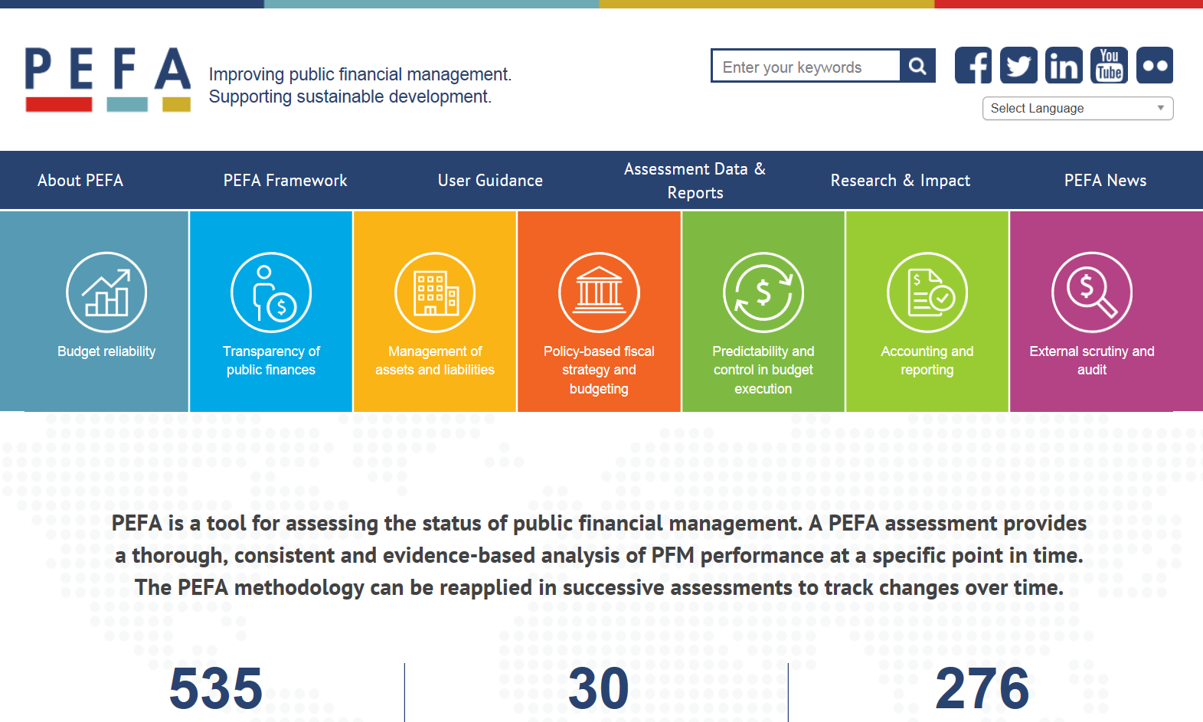
Get in touch with the PEFA Secretariat
www.pefa.org
PEFA Newsletter
#PEFA2016

